Slide 1

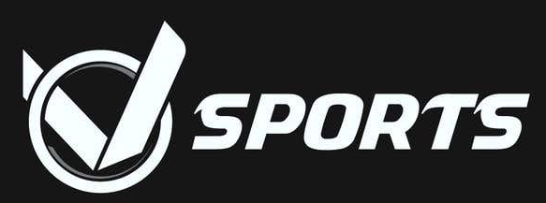
SPORTS WEAR WEBISTE DEVELOPMENT
By
Rachana K
Althaf S
Sanjay M
Manjunath T

Slide 2
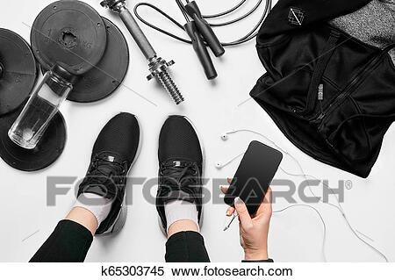
Introduction
Sports and sports wear are related to each other. Sports are very important for health and also for our life. Sportswear originally described clothing made specially for sports.
Some examples of Sportswear: Aerobic clothing, Athletic clothing, Football clothing, Cricket clothing, Games shorts, Gloves, Jackets, Pants, Shirts, Shorts, Socks, Swimwear Tennis clothing.

Slide 3
Introduction
This is a website which helps to shop Sportswear products on your finger tips. We are Launching this website with new brand name called, " Vsports. "
We have developed six modules as follows,
Home page
Men’s module
Women’s module
Accessories module
About Us page and
Login/Register page

Slide 4
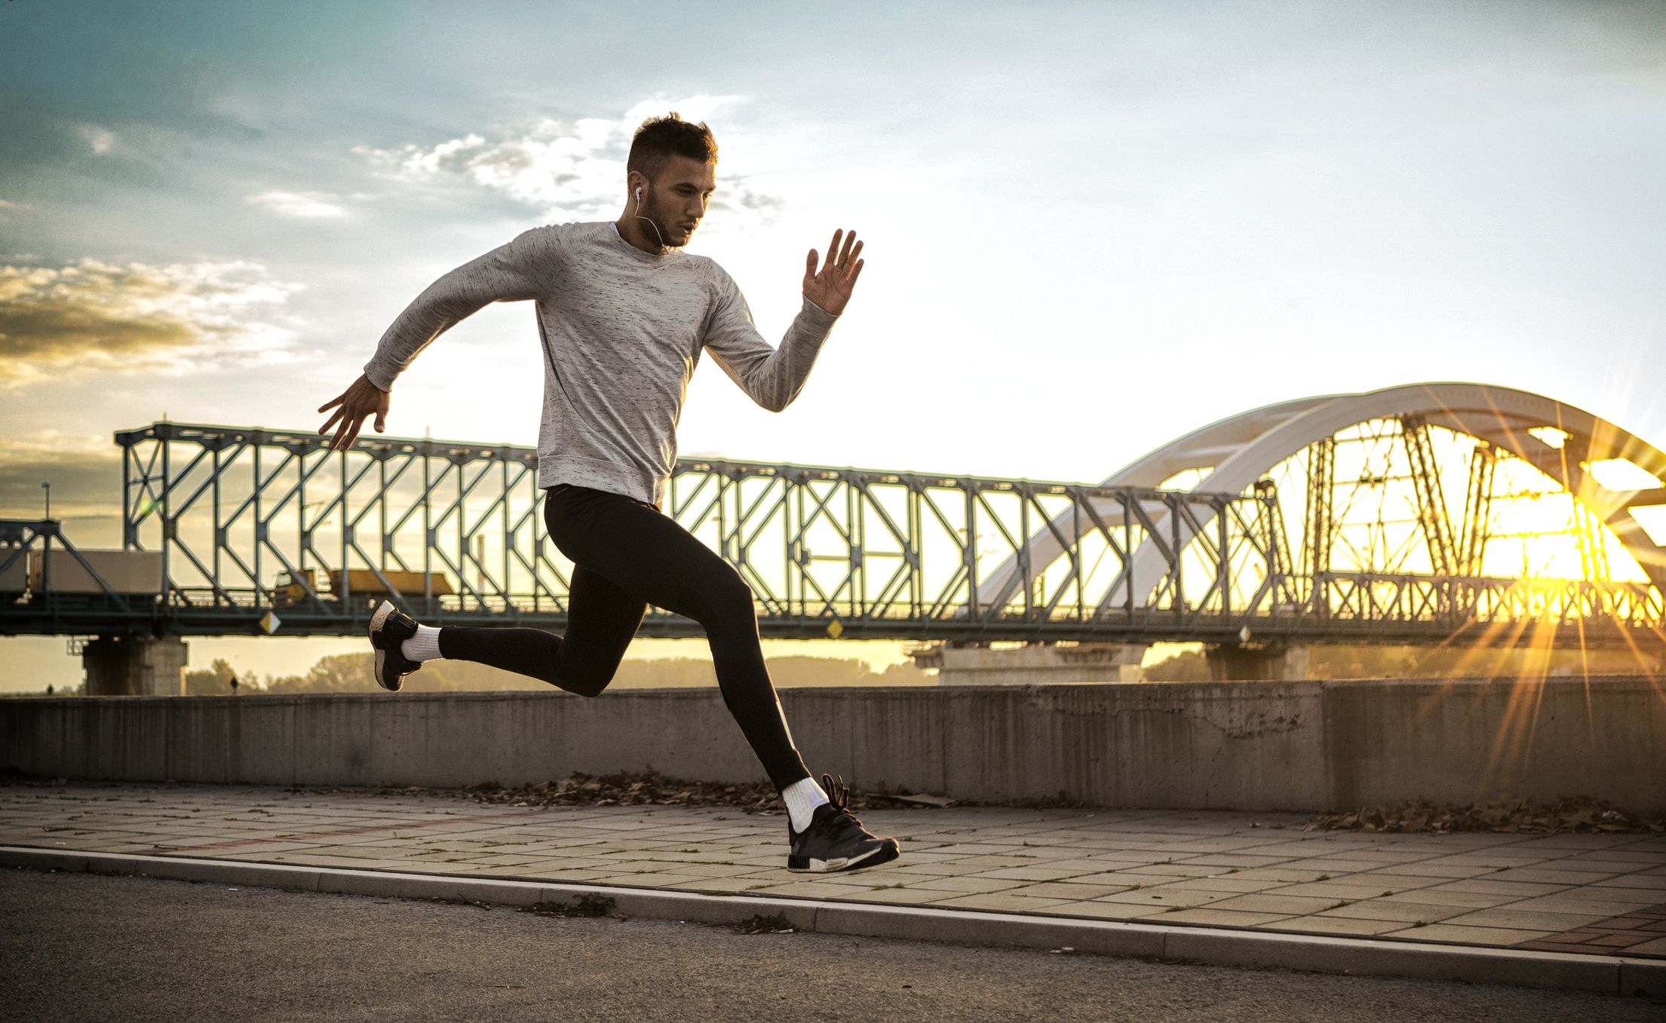
Why sports wear?
Sportswear requires aesthetic features such as an attractive appearance and a pleasant look as well as functions that improve athletes’ performance, provide extra comfort and promote the health of the wearer.
Sports wear will give us : comfort during play
and protection our body at play.

Slide 5
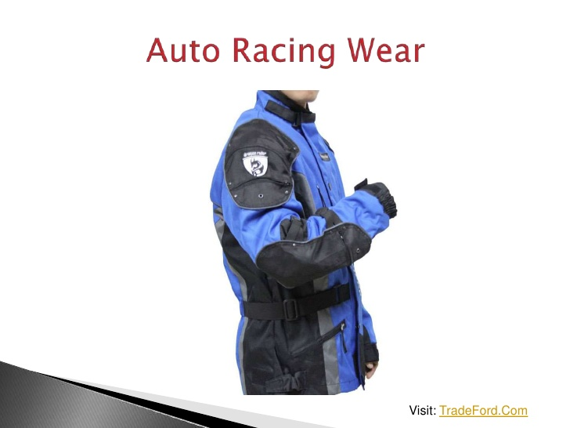
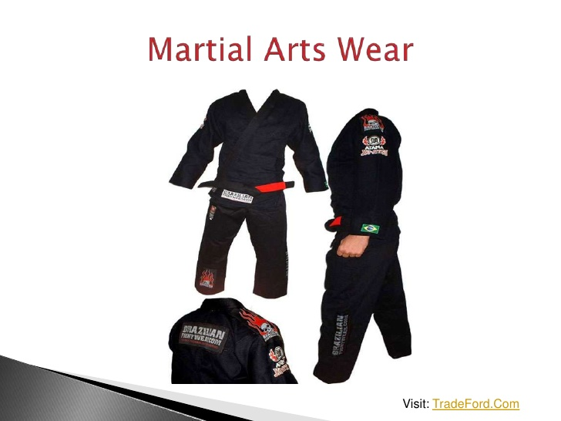
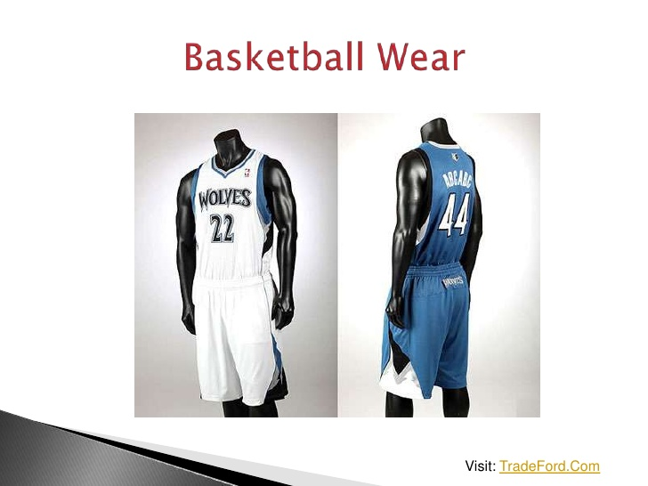
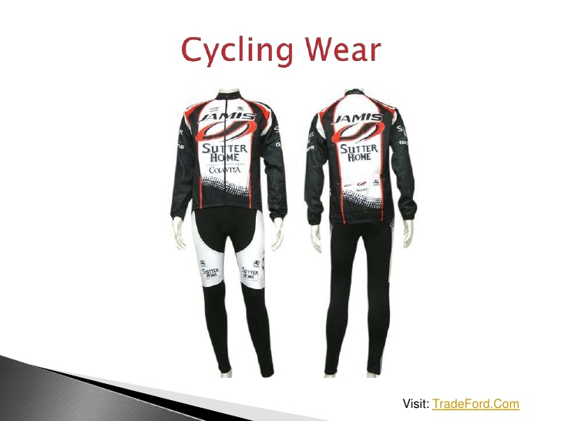
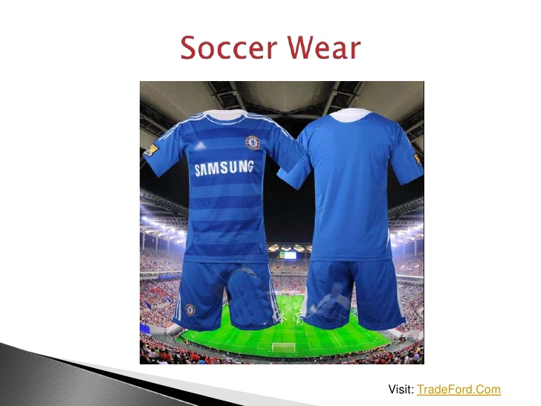
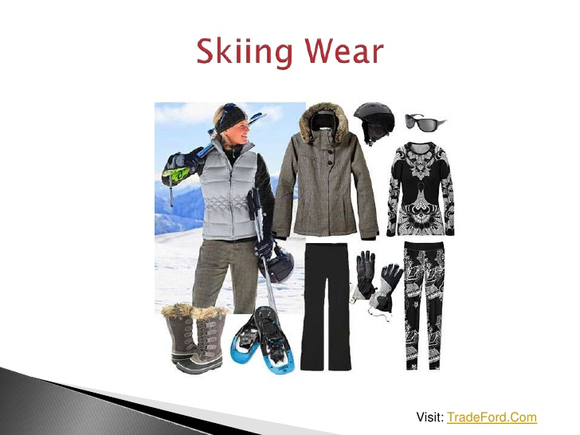
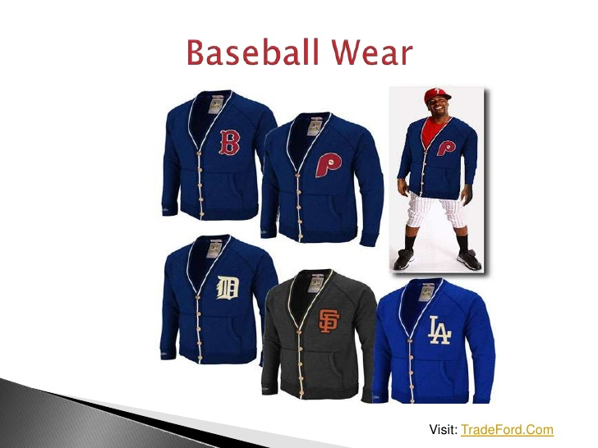
Types of sports wear products

Slide 6
Have a look of our website pages…..

Slide 7
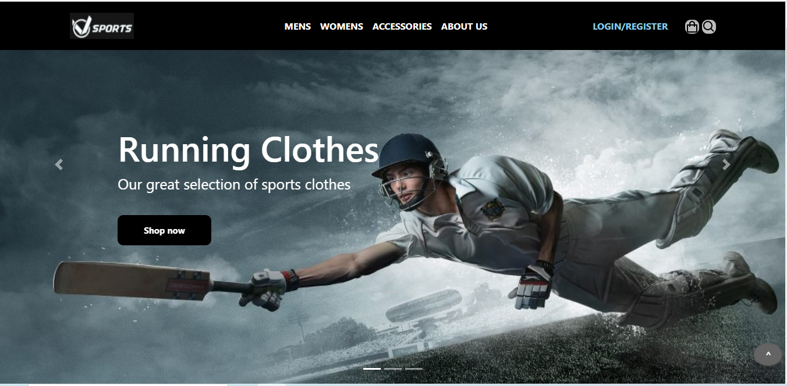
Home page
Shows carousal and header part

Slide 8
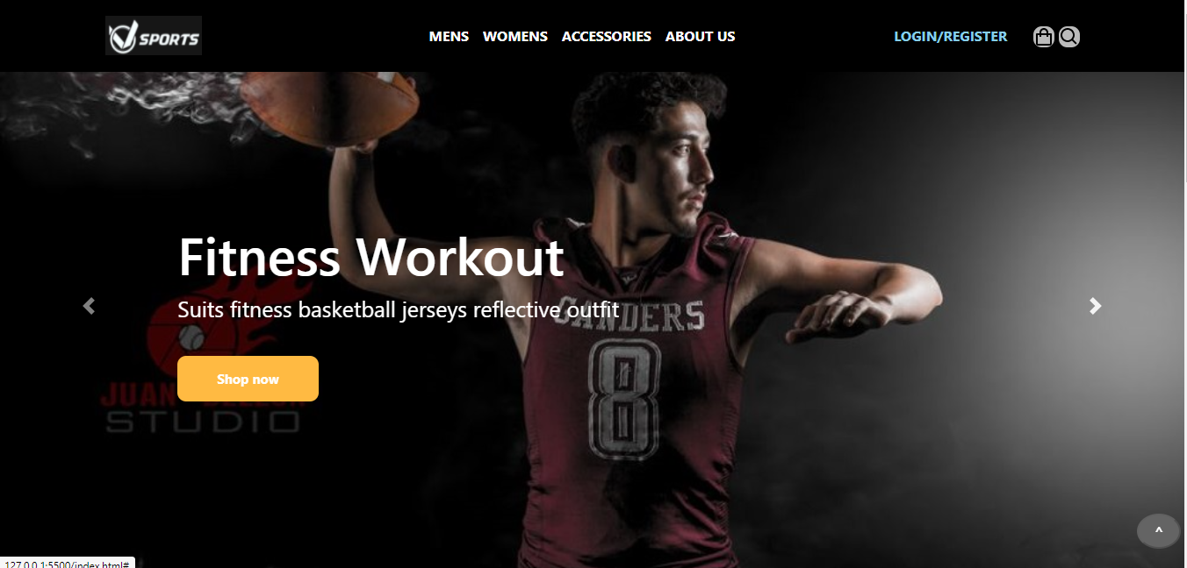
Home page
Shows carousal and header part

Slide 9
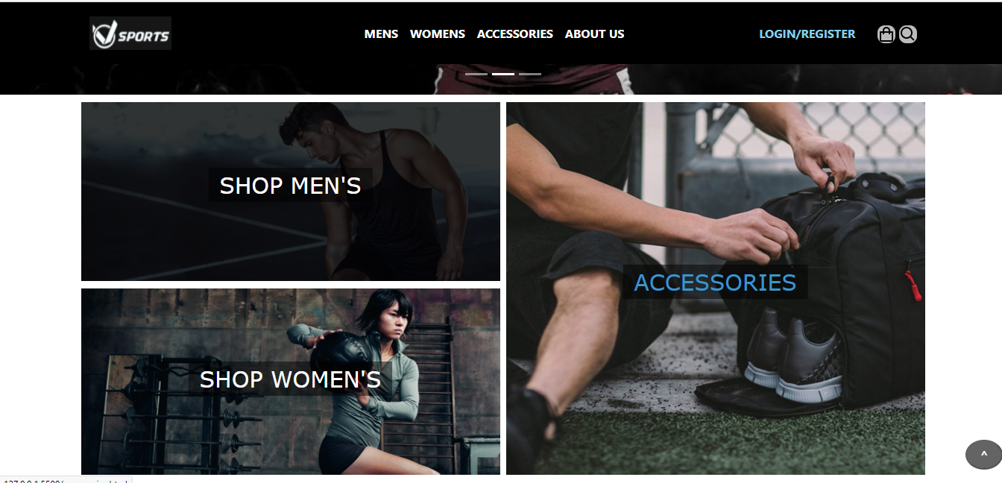
Home page
Shows body middle shopping part

Slide 10
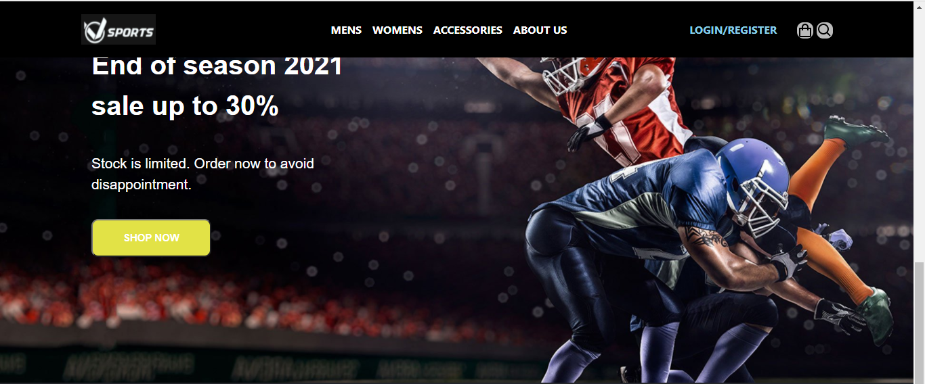
Home page
Shows section three of the home page

Slide 11
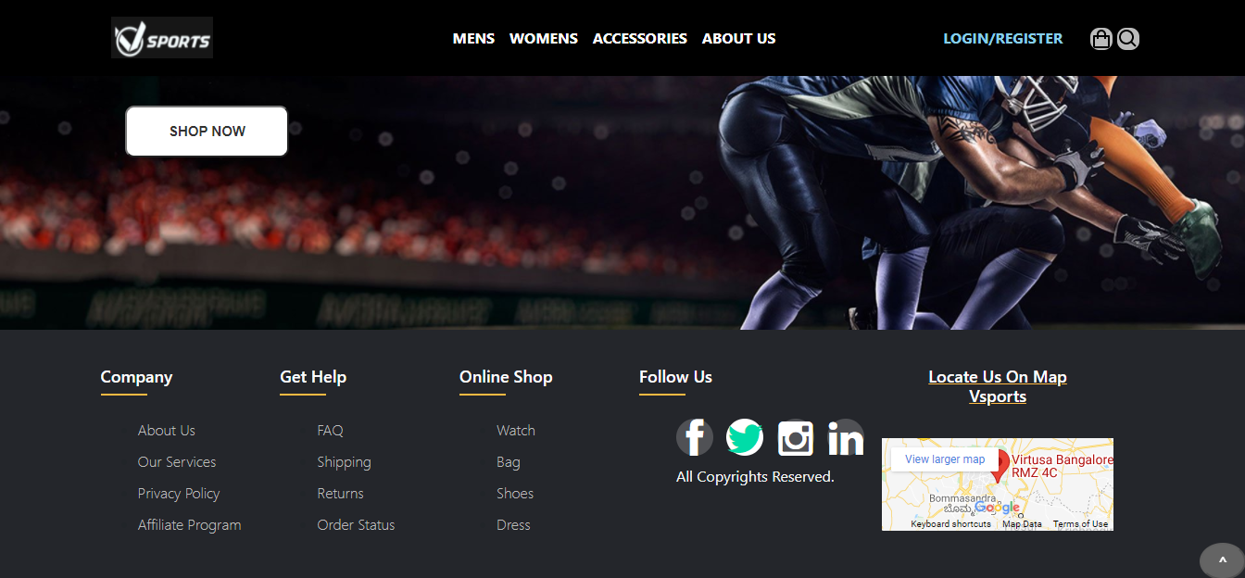
Home page
Shows footer part

Slide 12
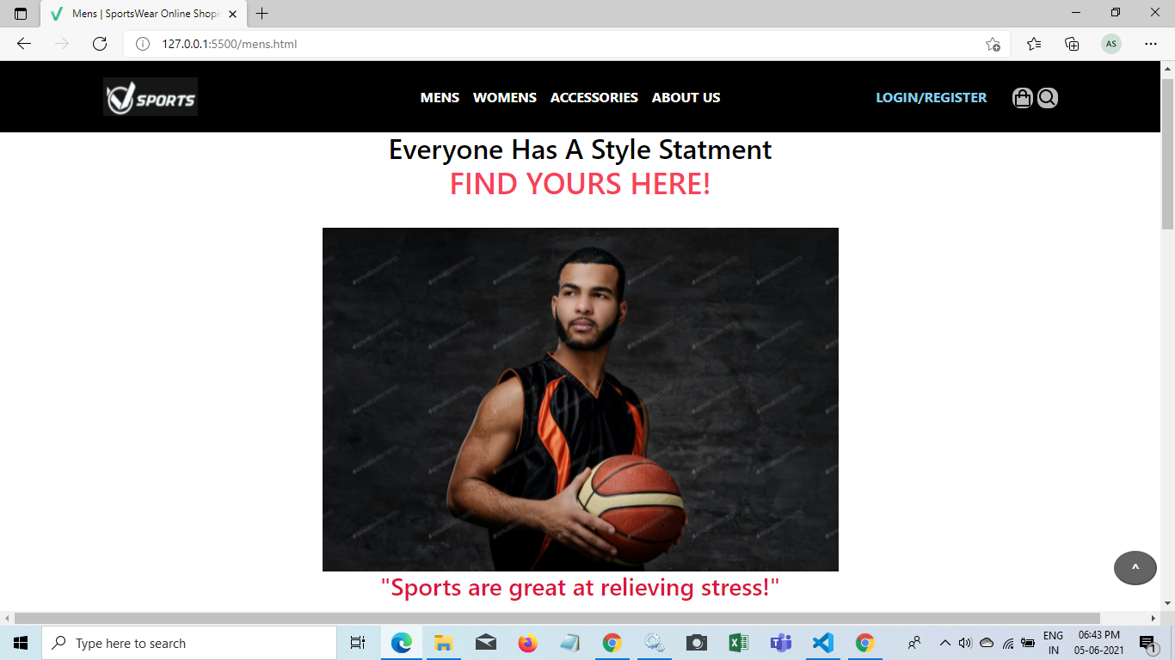
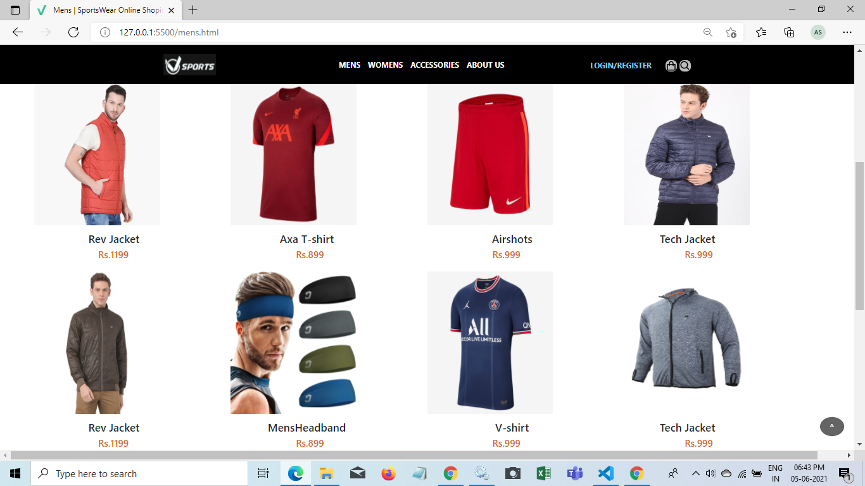
Men’s page

Slide 13
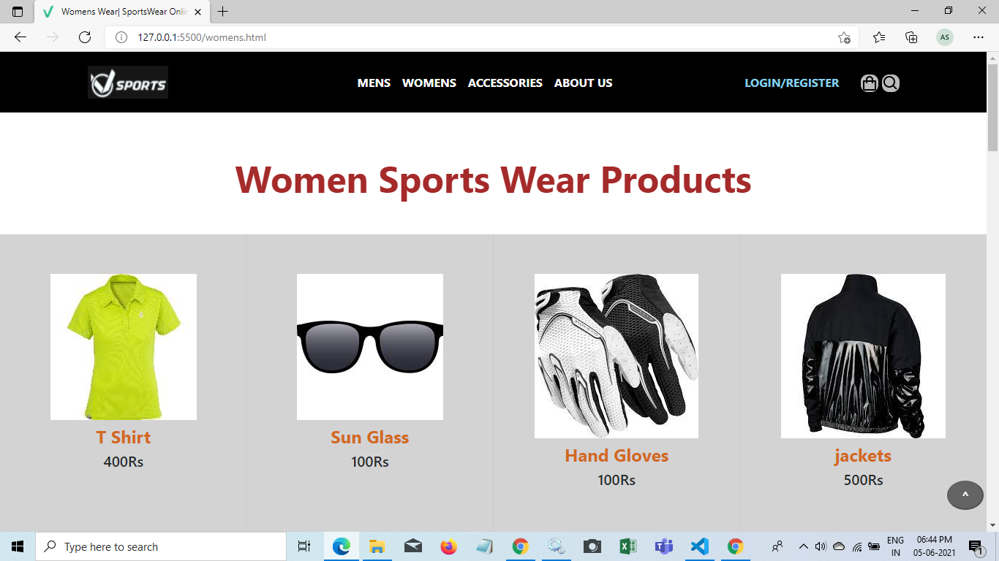
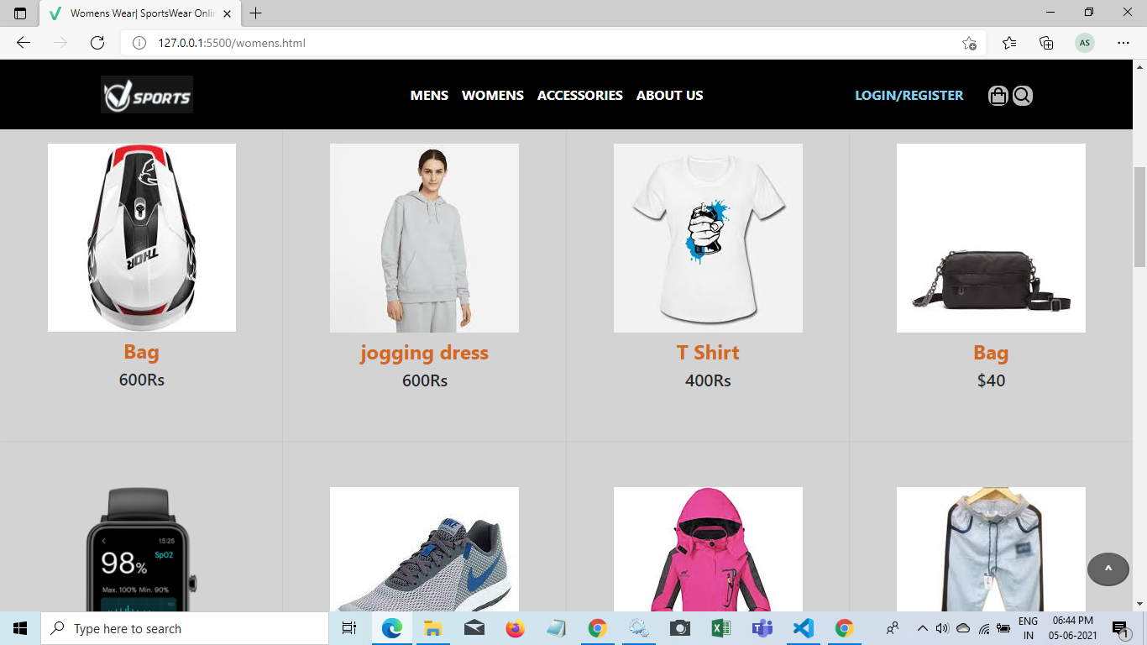
women’s page

Slide 14
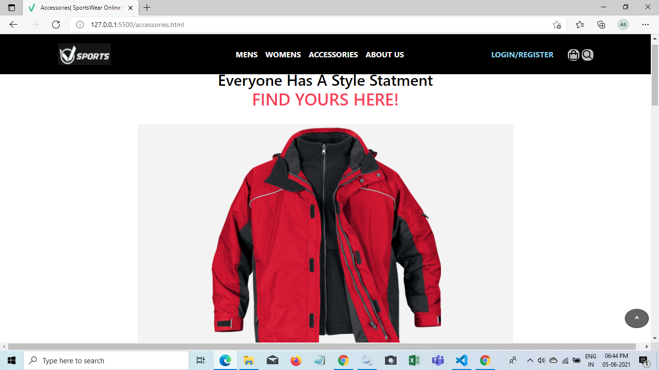
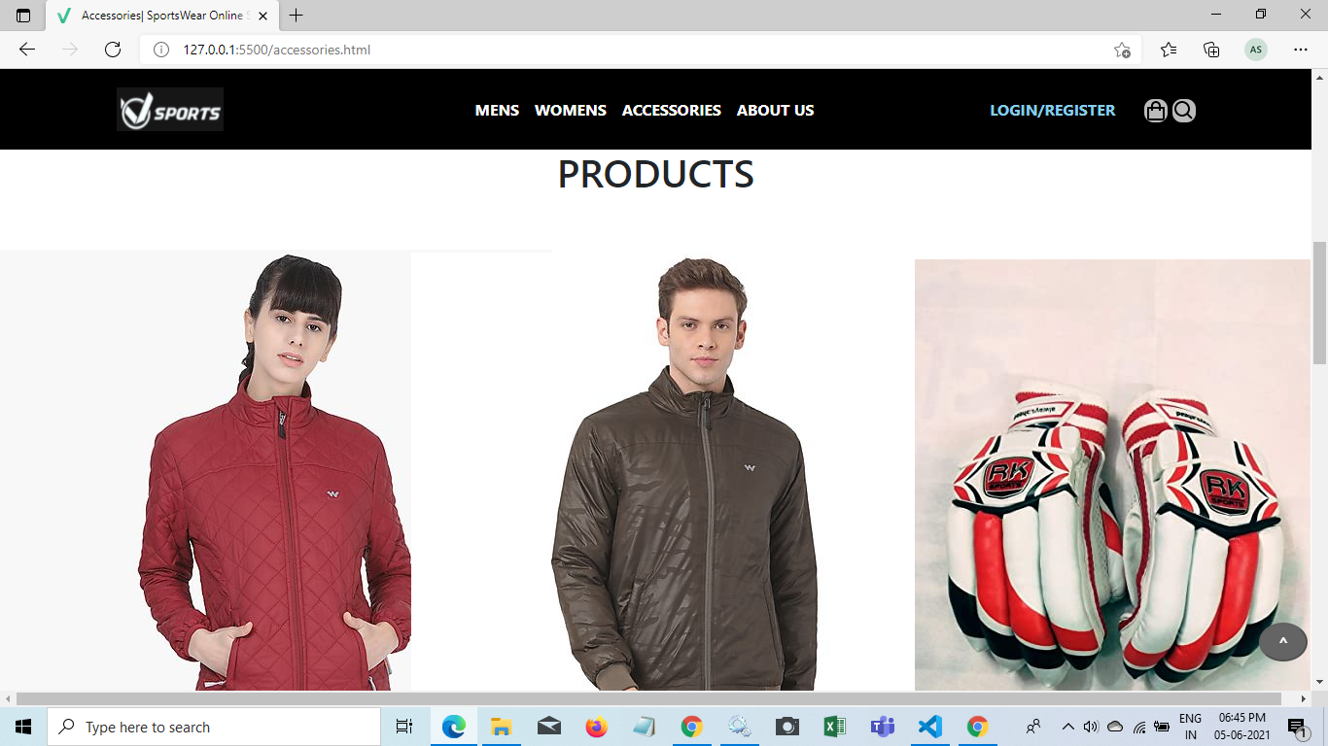
Accessories page

Slide 15
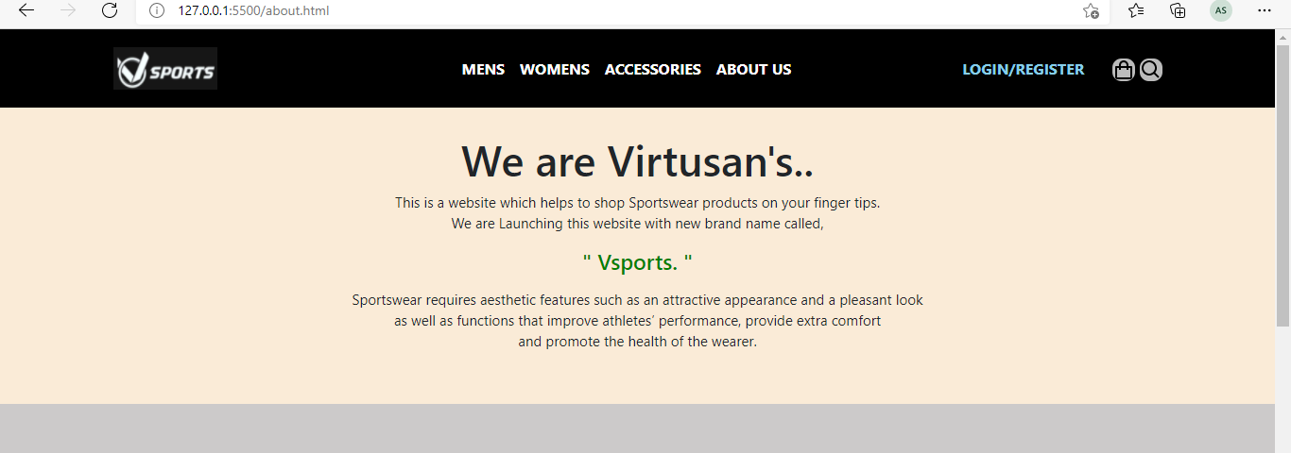
About us page

Slide 16
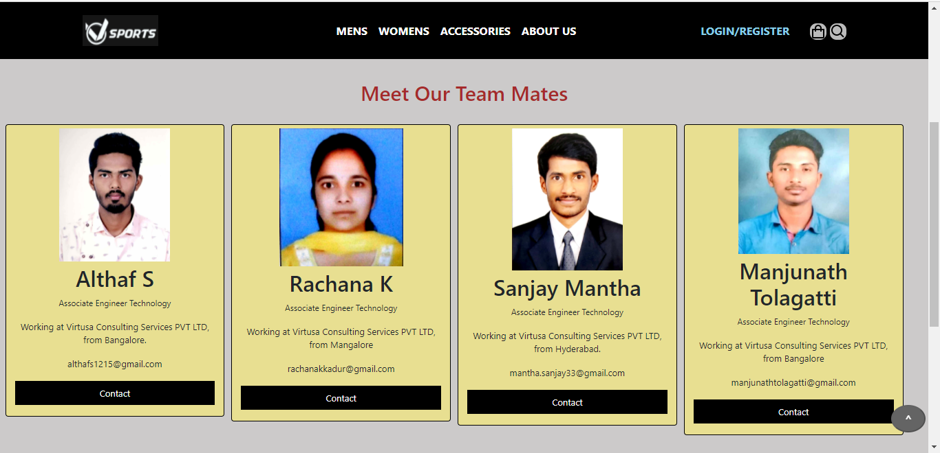
About us page

Slide 17
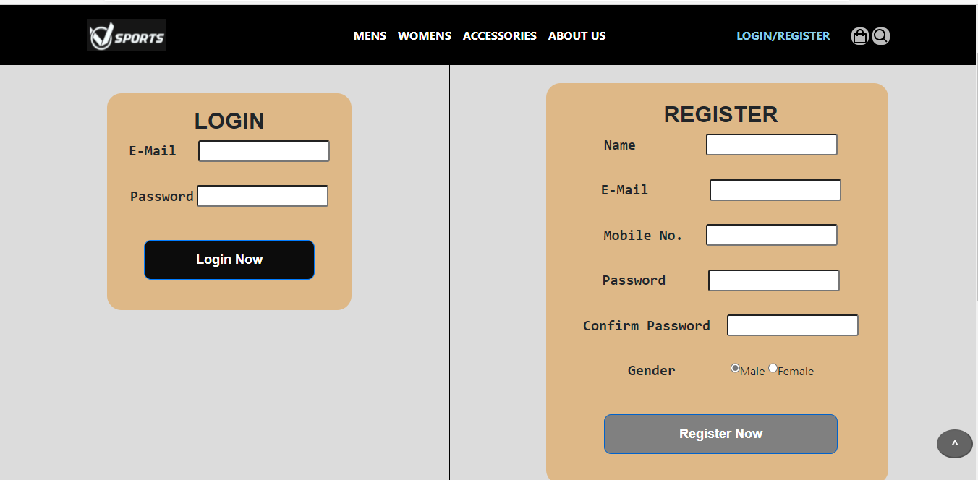
Login/Register page

Slide 18
Conclusion
Sportswear are used to give comfort, safety, motivation and specific identity. Day by day sportswear has become scientific and more adorable. It can be said that sportswear will be a bigger textile market one day.
We have developed this website by equally dividing work as follows,
Home page- Everyone.
Men’s page- Manjunath
women’s page- Rachana
Accessories page- Sanjay
About us and Login page- Althaf S.

Slide 19


